Slide 1
Super Typhoon Rammsun Case Study
Ling Zhang
Dec,11,2015,Group meeting, PSU

Slide 2
outline
Why I choose Rammasun?
synoptic analysis and diagnostic analysis
NWP Simulation case study
Discussion

Slide 3
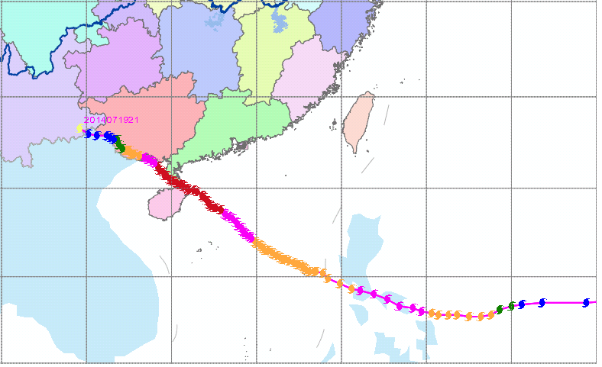
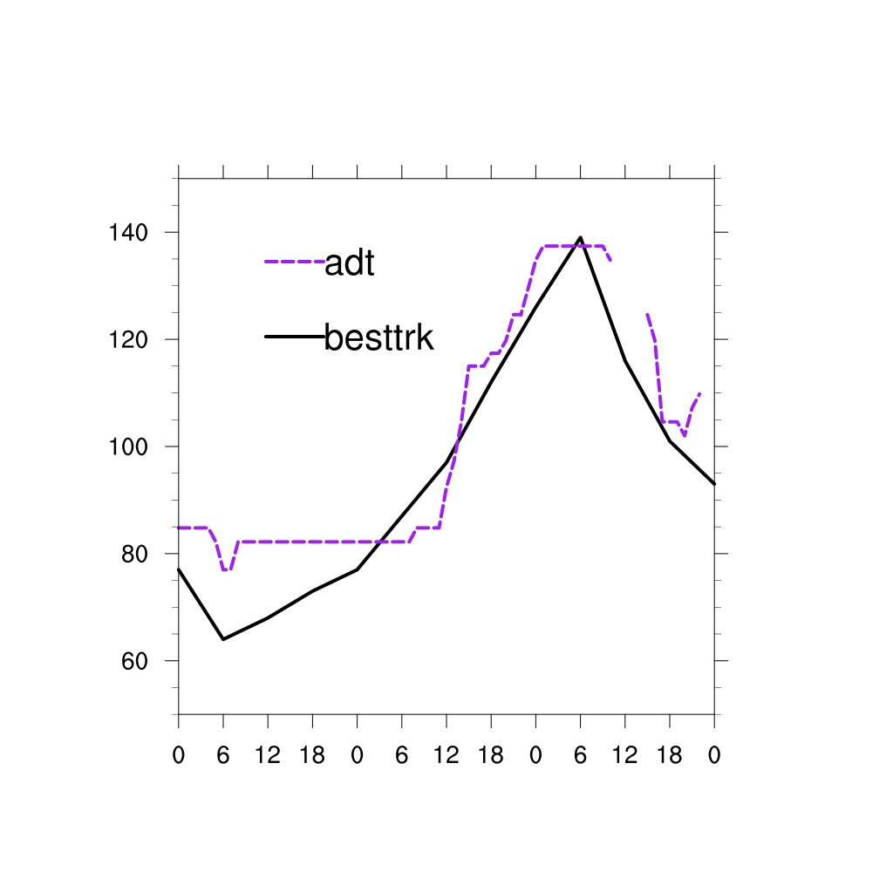
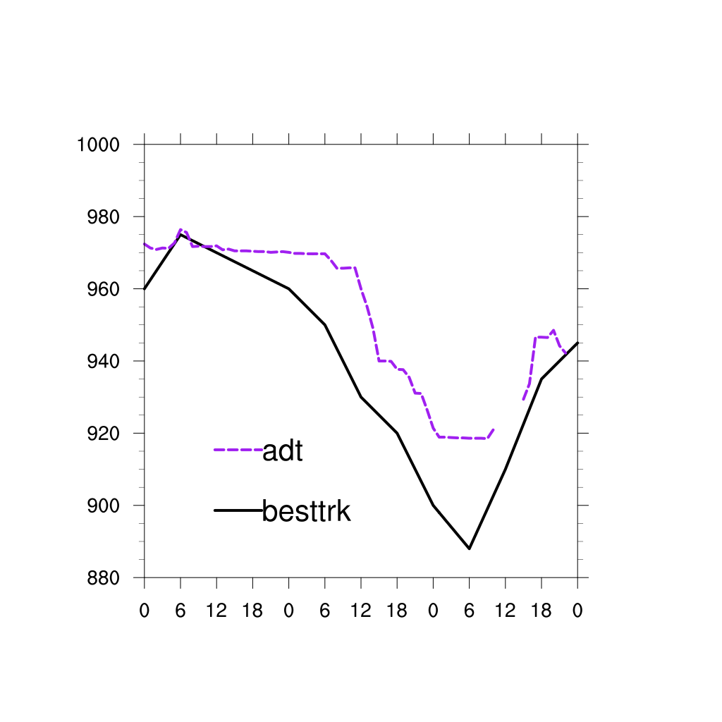
Rammasun is the strongest typhoon landfall in China since there is meteorological data.
It intensified near coast.
Rammasun maximum intensity is 70m/s,140kts,minimum surface pressure 888hPa.
Maximum wind(kts)
Surface pressure(hPa)
jul16
jul17
jul18
jul19
jul16
jul17
jul18
jul19

Slide 4
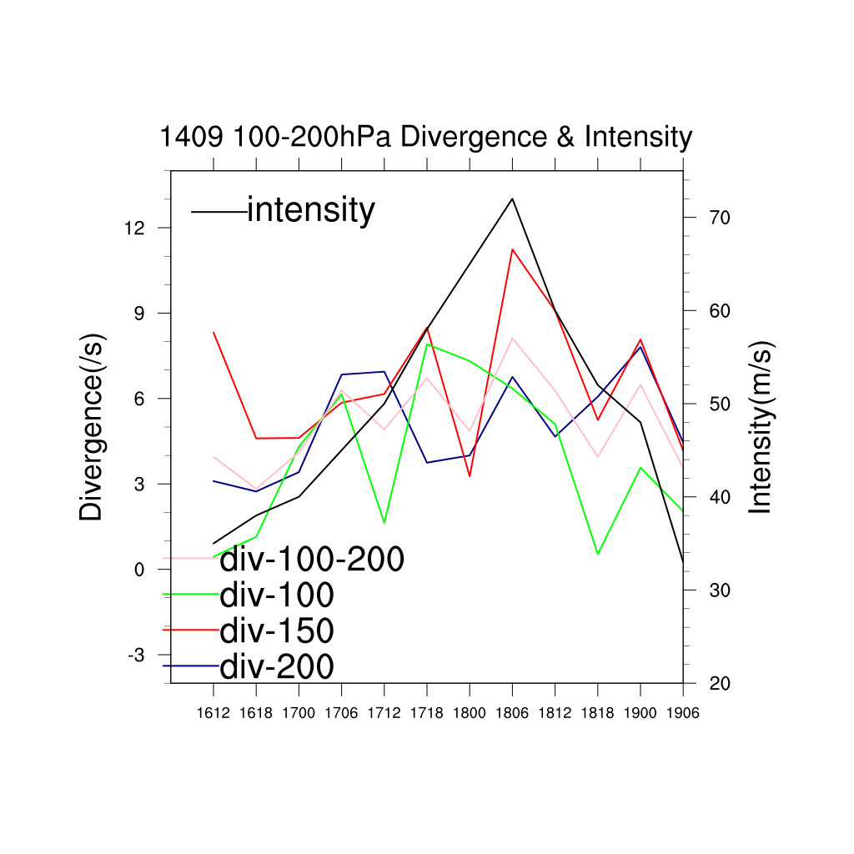
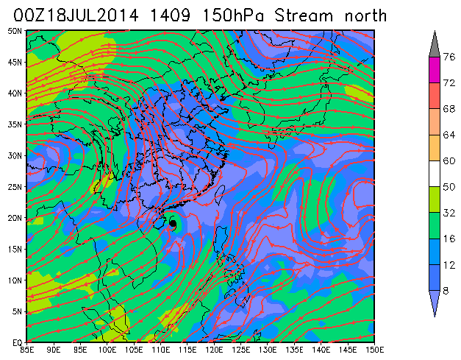
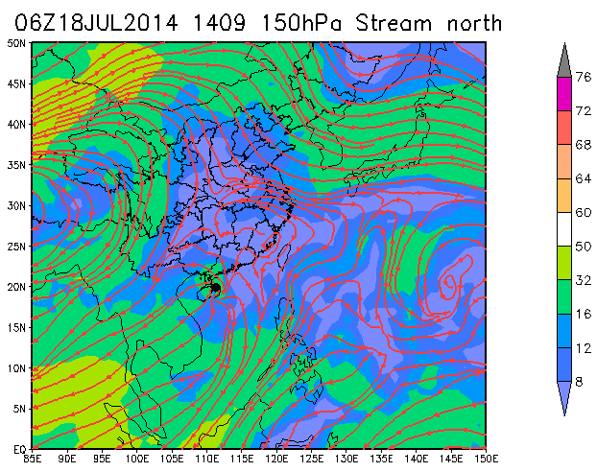
Radius 200km averaged divergence
1800UTC-1806UTC is a key period.

Slide 5
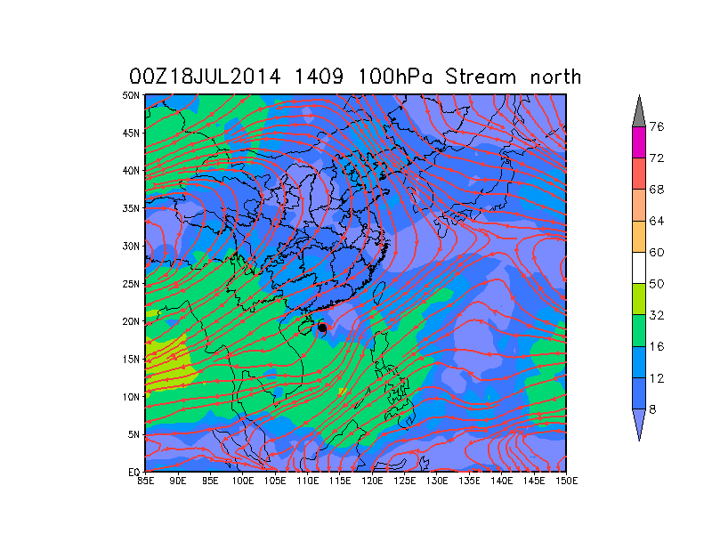
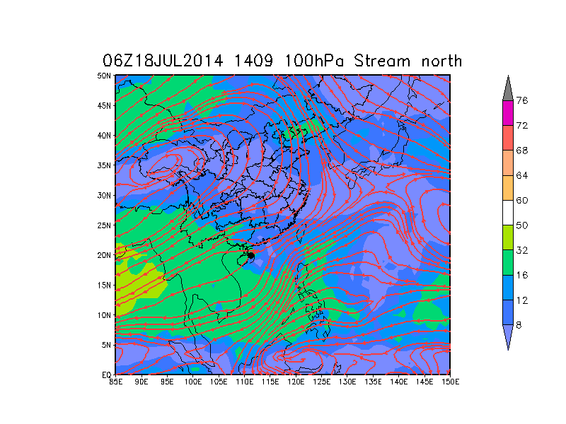
Anticyclone moved northeastward obviously from 1800UTC to 1806UTC.
Offshore intensify accompanies upper level circulation changed .

Slide 6
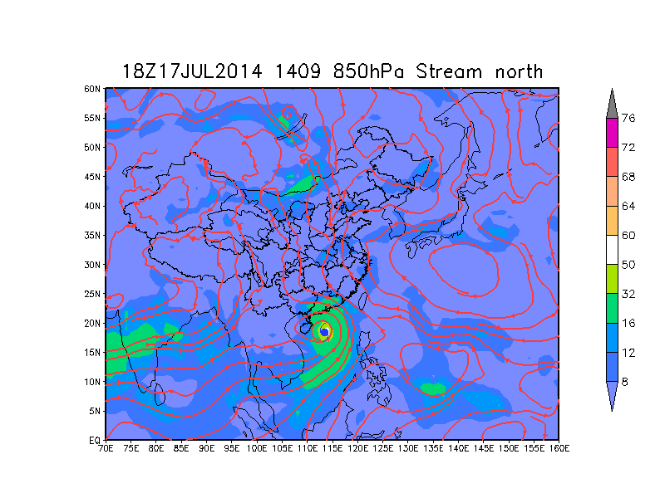
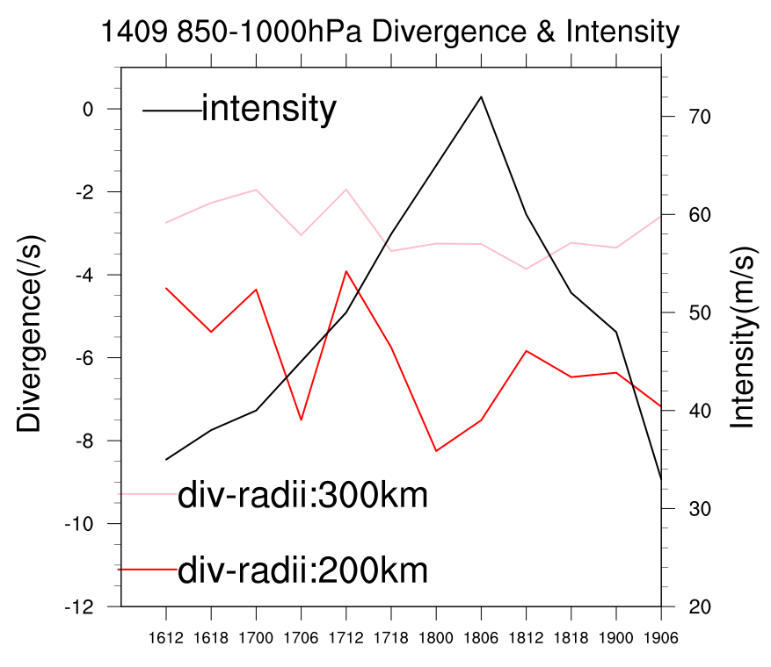

Slide 7
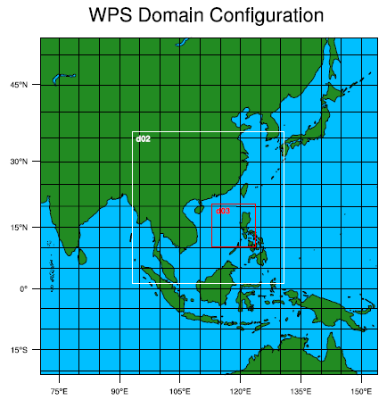
WRF simulation
D01:299*299,27km
D02:403*403,9km
D03:343*343,3km
Vertical level:43
PTOP:50hpa
7 run :1518UTC ---1818UTC
1600UTC---1900UTC
1606UTC---1906UTC
1612UTC---1912UTC
1618UTC---1918UTC
1700UTC---1912UTC
1706UTC---1918UTC
No any assimilation

Slide 8
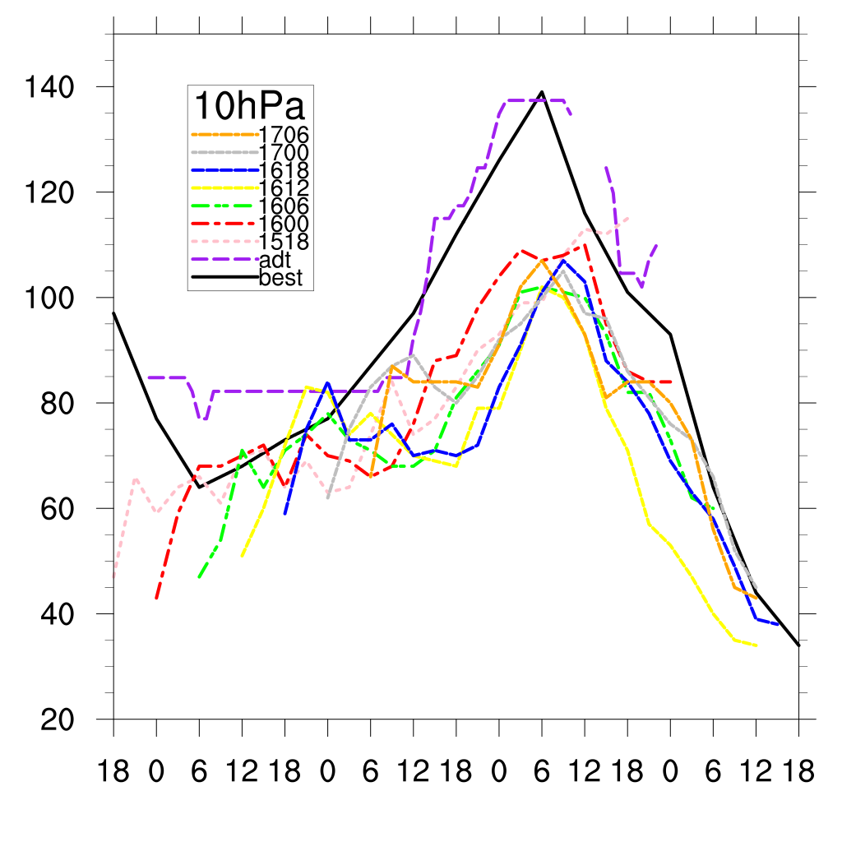
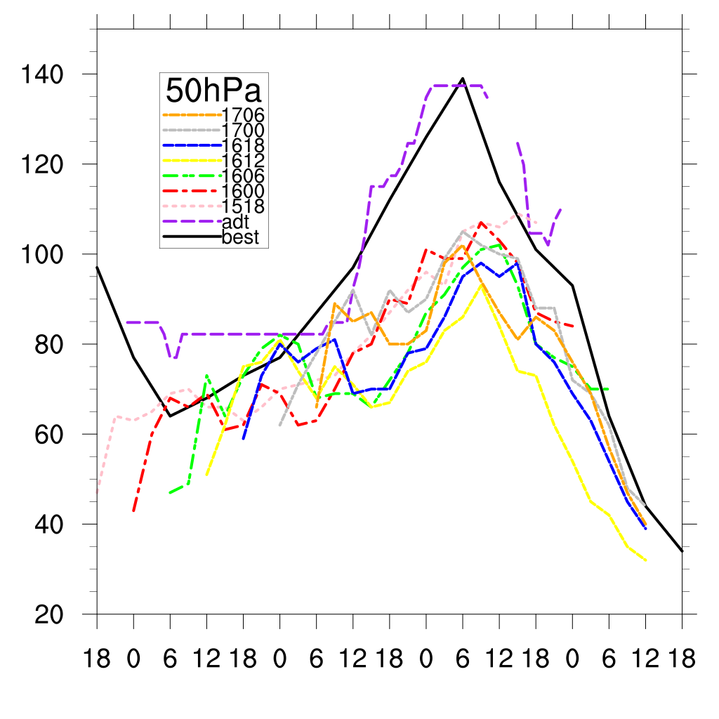
In order to enhance TC intensity, test to promote PTOP to 10hPa.
jul16
jul17
jul18
jul19
jul6
jul17
jul18
jul19
After promote PTOP from 50hPa to 10hPa, 4 run(1600,1612,1618,1706) out of the 7 run, TC intensity have obvious promotion. The promotion extent is about 5-10kts. Maybe there is some valuable topic worth to be done.

Slide 9
50hPa-43
10hPa-43
10hPa-46-gao
PTOP:10hPa
σ=0
PTOP:10hPa
σ=0
3σ
PTOP:50hPa
σ=0
50hPa
43σ
43σ
43σ
1000hPa
σ=1
1000hPa
σ=1
1000hPa
σ=1

Slide 10
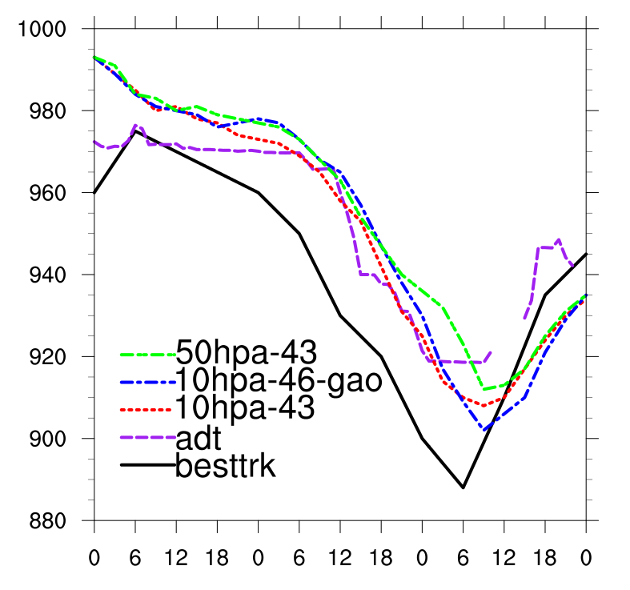
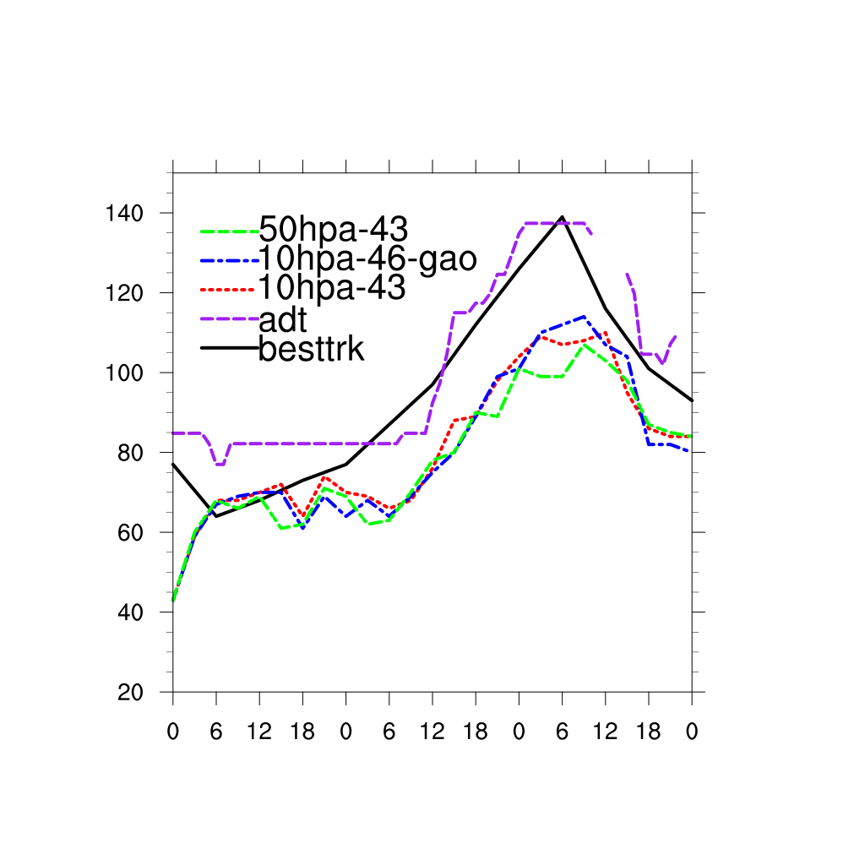
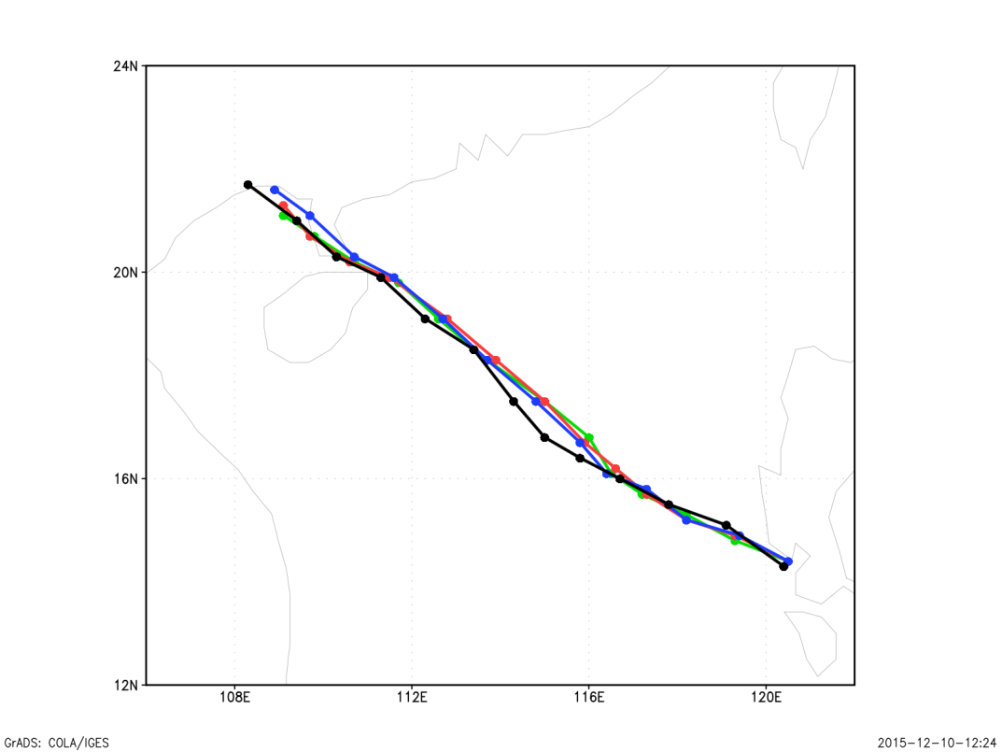
Maximum wind(kts)
Surface pressure(hPa)
t17
t20
jul16
jul17
jul18
jul19
jul16
jul17
jul18
jul19
10hPa-46(blue) is strongest.
10hPa-43(red) is take second place.
50hPa-43(green)is the weakest.
Notes:
1234

Slide 11
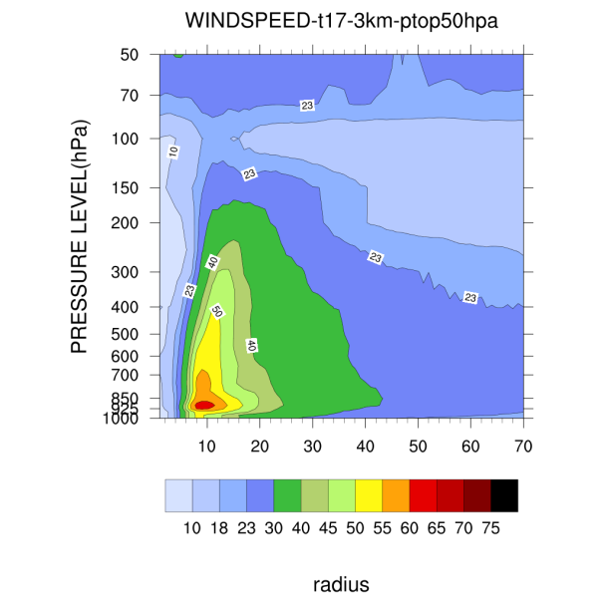
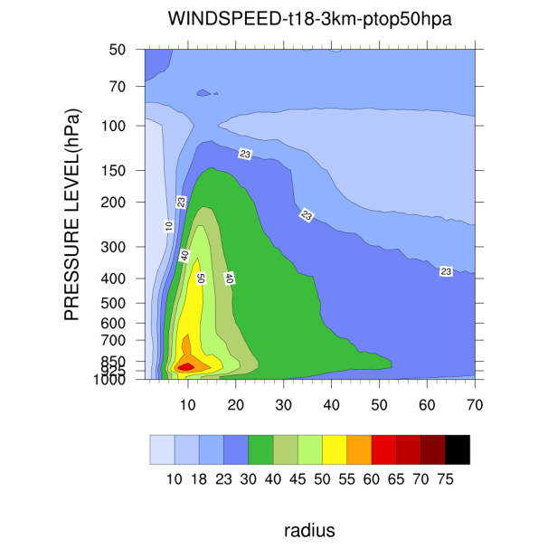
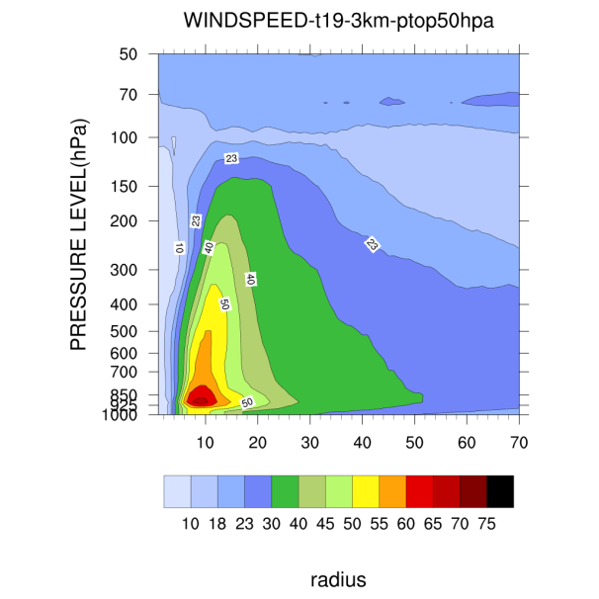
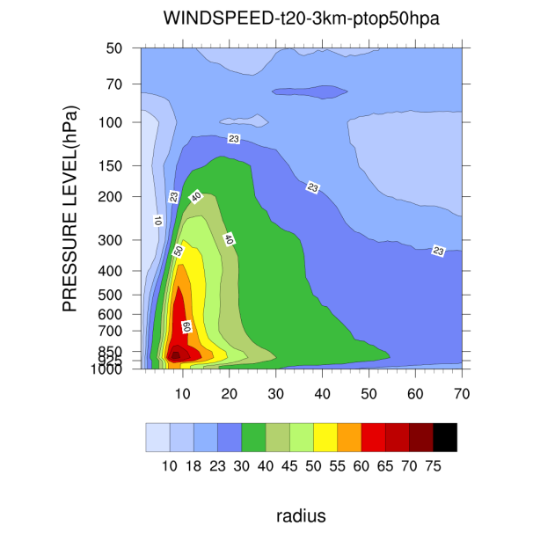
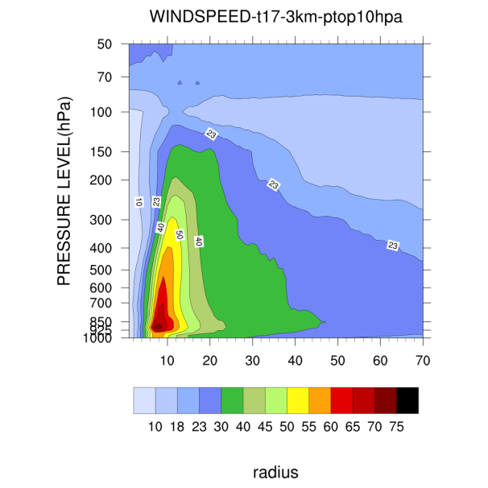
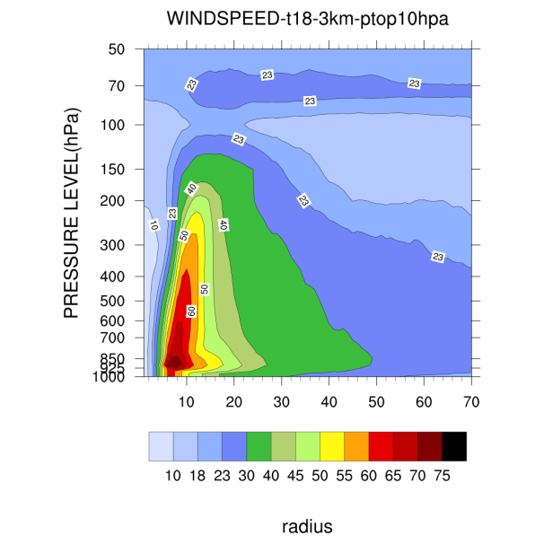
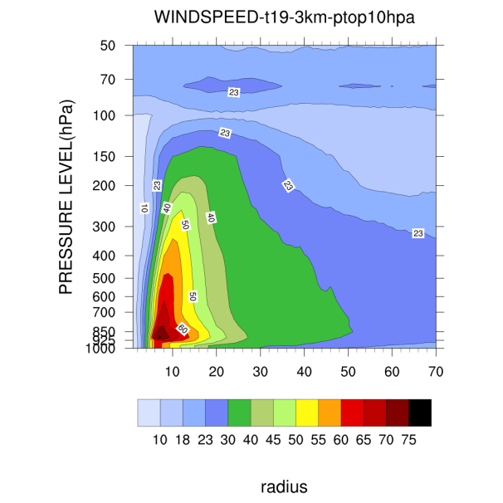
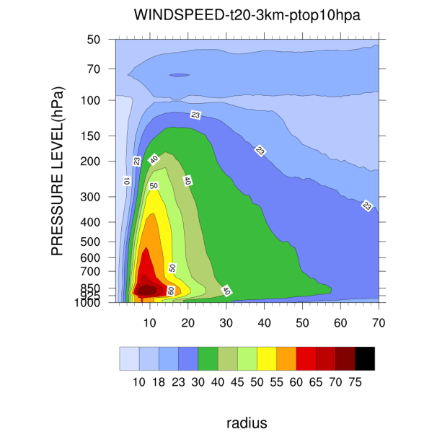
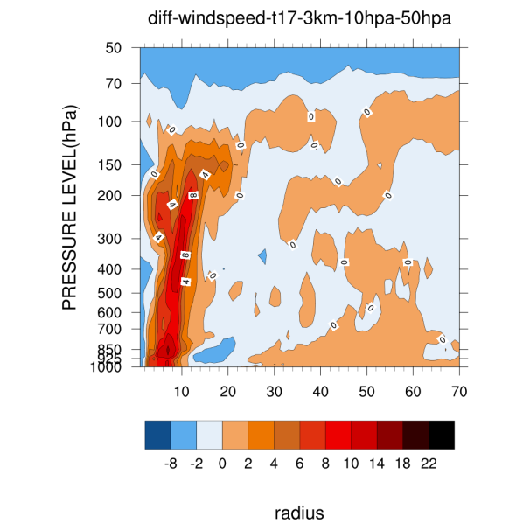
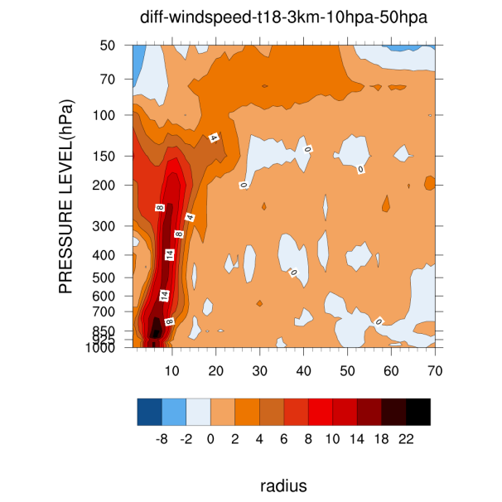
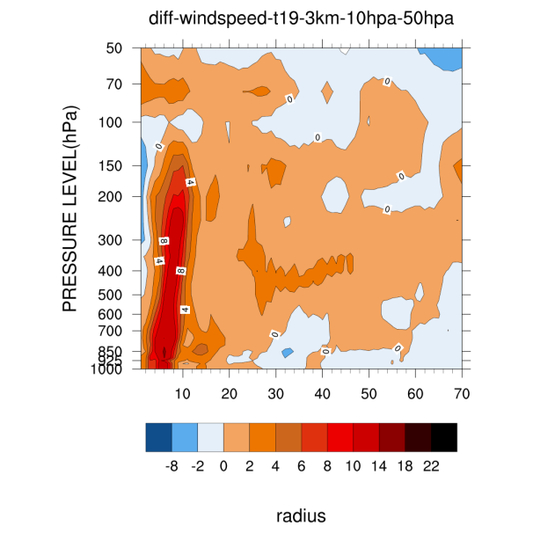
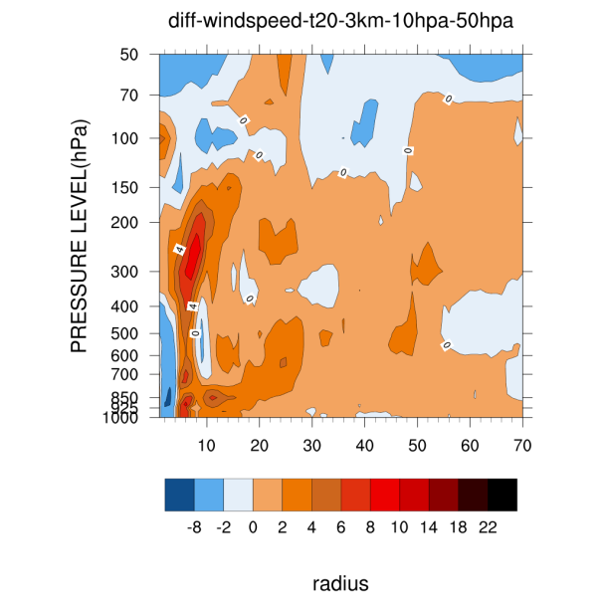
50hPa
10hPa
Diff-WINDSPEED
10-50hPa

Slide 12
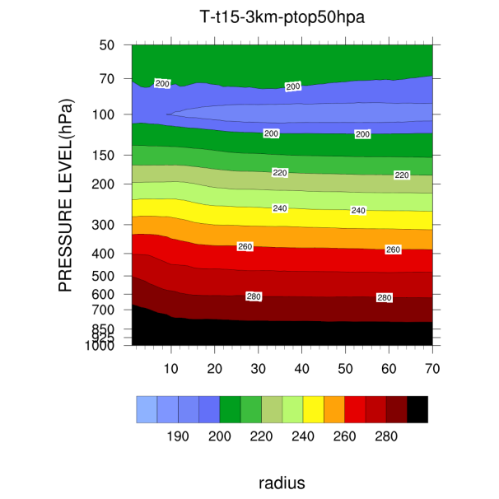
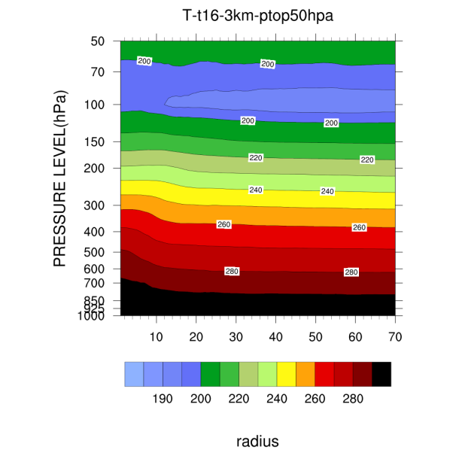
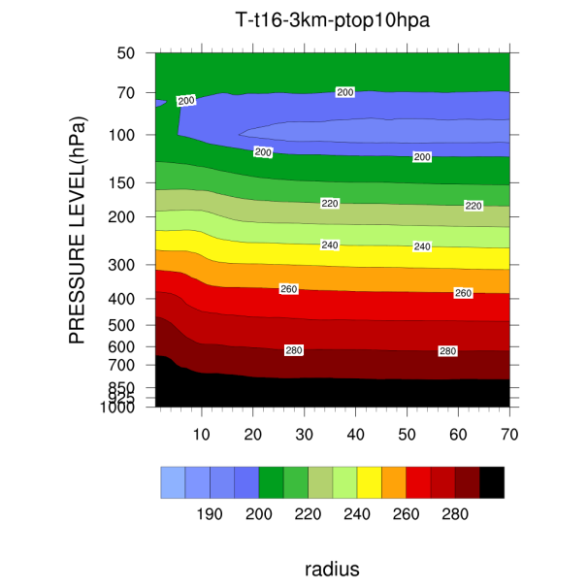
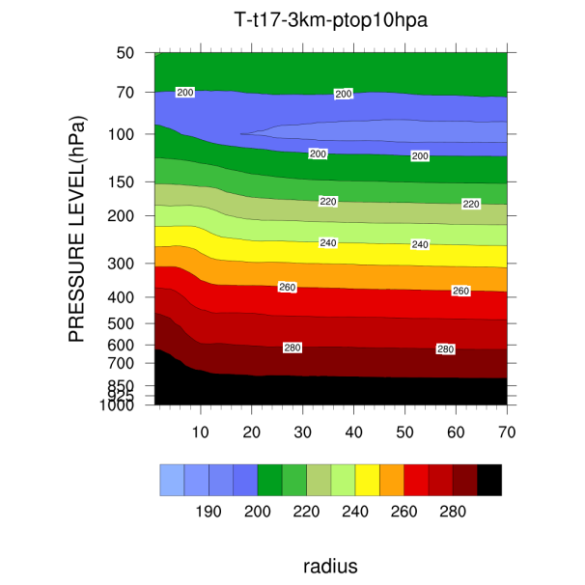
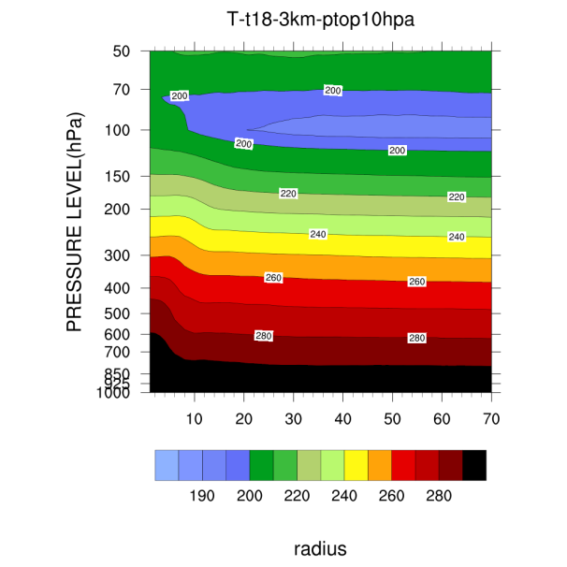
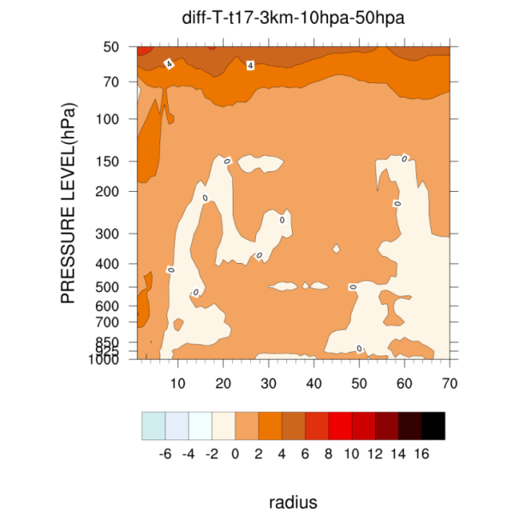
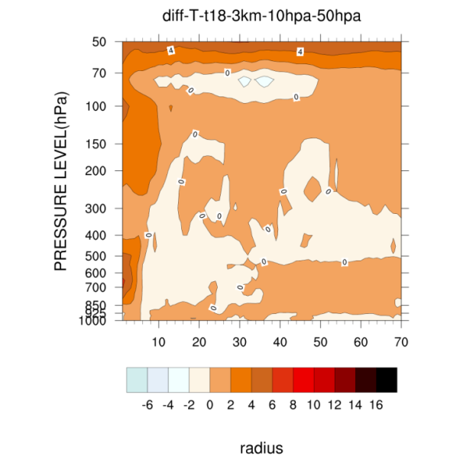
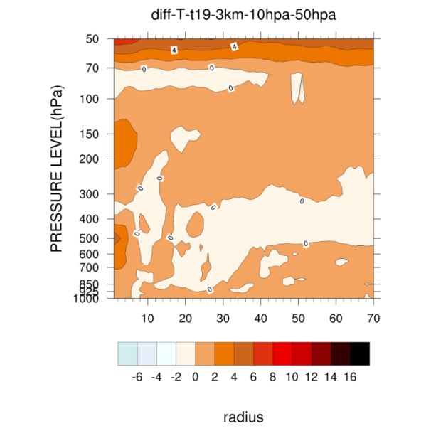
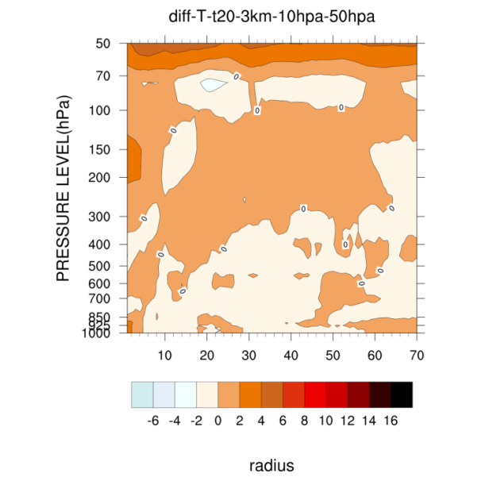
50hPa
10hPa
Diff-T
10-50hPa

Slide 13
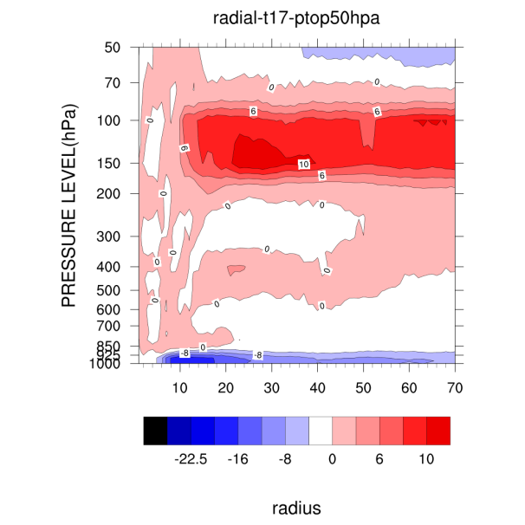
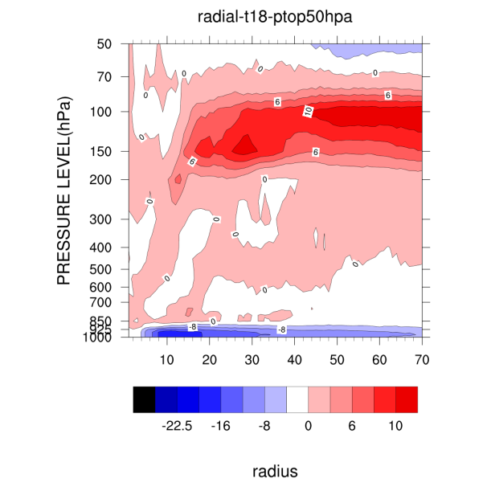
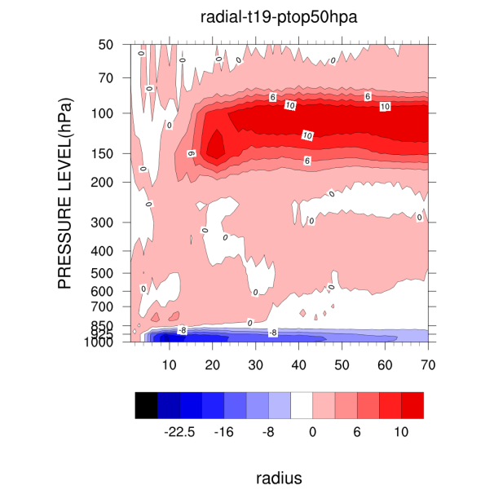
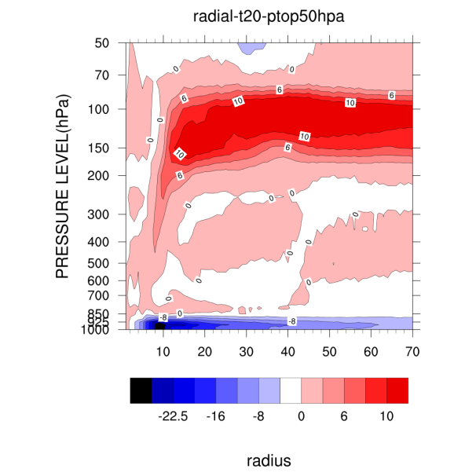
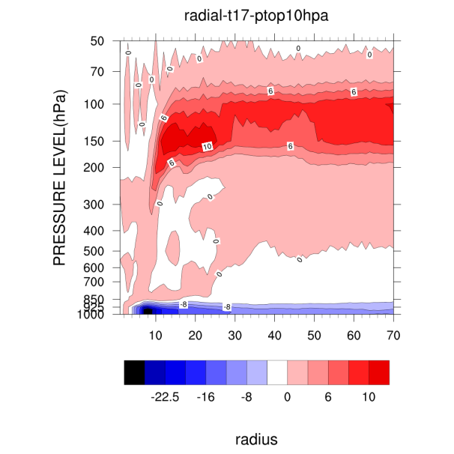
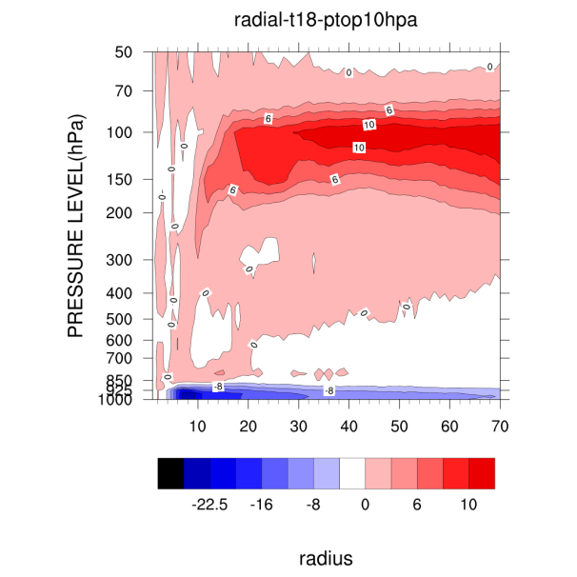
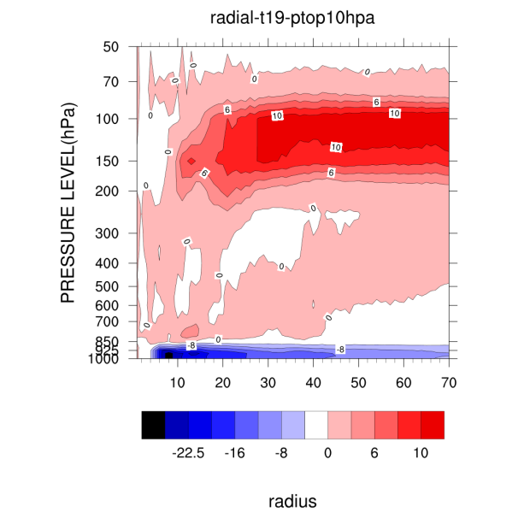
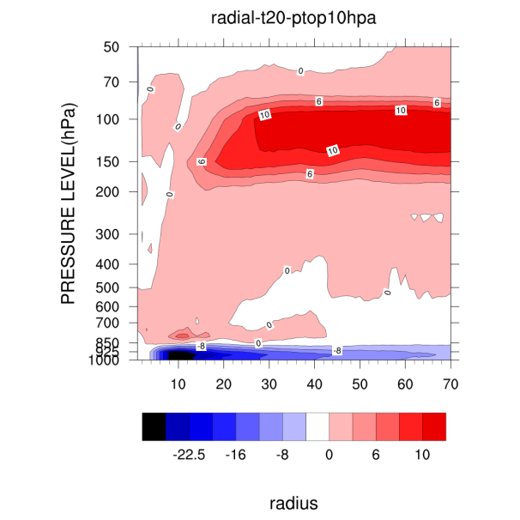
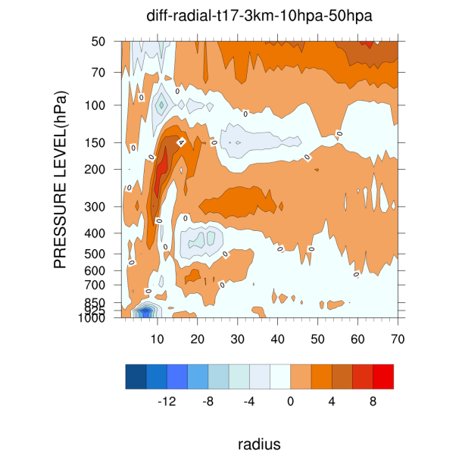
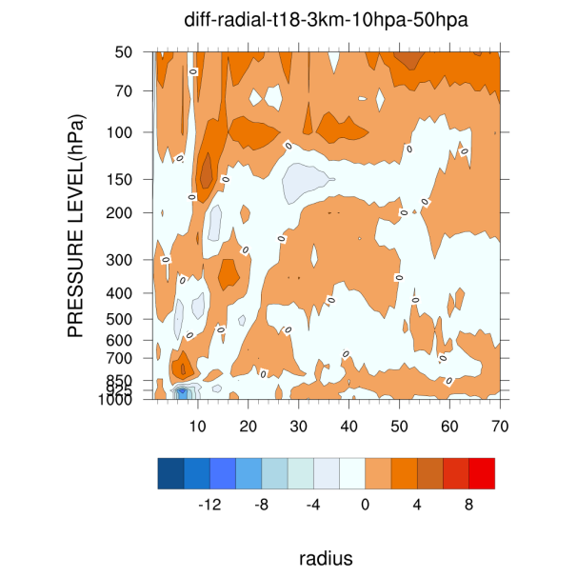
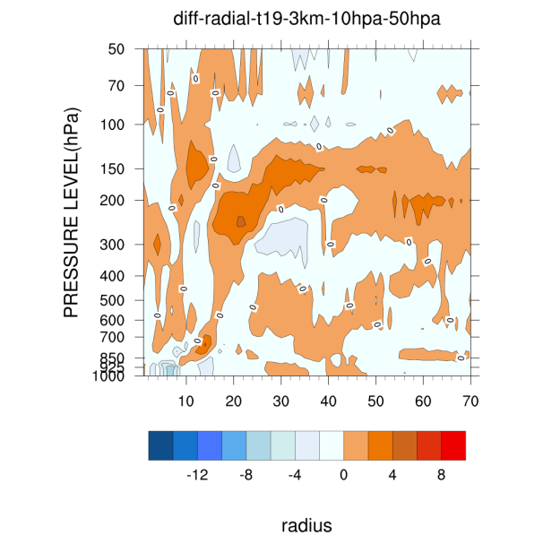
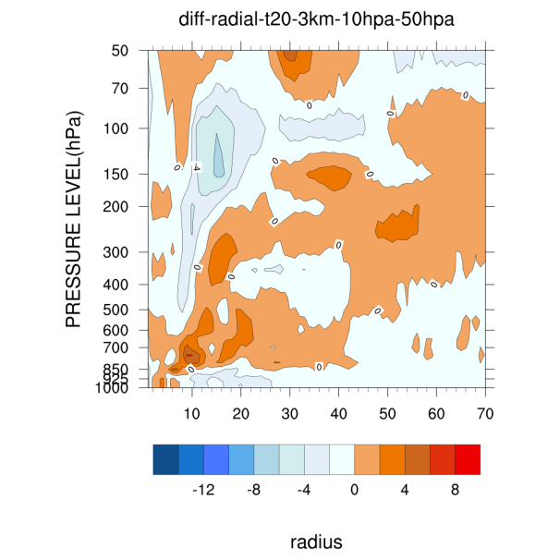
50hPa
10hPa
Diff-radial
10-50hPa

Slide 14
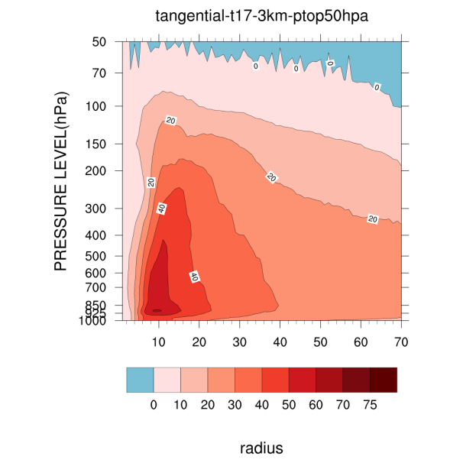
50hPa
10hPa
Diff-tangential
10-50hPa

Slide 15
Difference PTOP 10hPa-PTOP 50hPa
Compared to PTOP 50hPa,PTOP 10hPa have characteristics as followed:
Near 70hpa lower temperature and stronger wind
Radial wind level even lower,pumping more efficient
Anticyclonic wind (circulation) near 70hPa even stronger

Slide 16
10hPa-46(blue) is strongest.
10hPa-43(red) is take second place.
50hPa-43(green)is the weakest.

Slide 17
Diff-T
10hPa-46-10hPa-43
Diff-WINDSPEED
10hPa-46-10hPa-43
Above 50hPa there is intermittent strong wind and warmer air.

Slide 18
Difference PTOP 10hPa-sigma46-PTOP 10hPa-sigma43
Compared to PTOP 10hPa-43sigma,PTOP 10hPa-46sigma have characteristics similar to PTOP 10hPa-43sigma compared to PTOP 50hPa-43sigma.
And above 50hPa , PTOP 10hPa-46sigma have even higher temperature and intermittent stronger wind and even stronger anticyclone.

Slide 19
50hPa-49-gao
10hPa-49-gao
In order to test the sensitivity of the air distribution (wind and temperature ) near 70hPa on TC intensity in this case ,two new WRF RUN were designed.
PTOP:10hPa
σ=0
PTOP:50hPa
σ=0
50hPa
70hPa
6σ
70hPa
6σ
100hPa
100hPa
49σ
49σ
1000hPa
σ=1
1000hPa
σ=1

Slide 20
Maximum wind(kts)
Surface pressure(hPa)
t17
t20
jul16
jul17
jul18
jul19
jul16
jul17
jul18
jul19
50hPa-49-gao (pink)is obviously stronger then 50hPa-43(green).--- just as expected
But 10hPa-49-gao(orange)is weaker than 10hPa-49(red) .---unexpected

Slide 21
Discussion
I have never pay attention to the affection of the distribution of atmosphere parameters near tropopause ‘s change on TC intensity change.
In this case, intensify near coast coincide with upper level circulation change, promote model PTOP and increase specific levels vertical resolution can enhance TC intensity effectively.
Up to now I can not give this intensity enhancement a reasonable dynamic explanation.

Slide 22
Thank you for your attention

Slide 23
Any question?

